Slide 1



Early Years Designated Safeguarding Leads Network Meeting Summer 2026

Slide 2
Housekeeping
To sign in– provide your name and setting in the Chat function
There will not be a break in the 2 hour session but please feel free to move around.

Slide 3
Agenda
Updates: Safeguarding in Education Team – Colin Clements
Safer sleep – updates from Sept 2026
BAND Updates – Julie Edwards
Early Years Updates – Fiona Townsend/Jayne MacIver

Slide 4
Helen MacDonald/Colin Clements
Safeguarding in Education Team

Slide 5
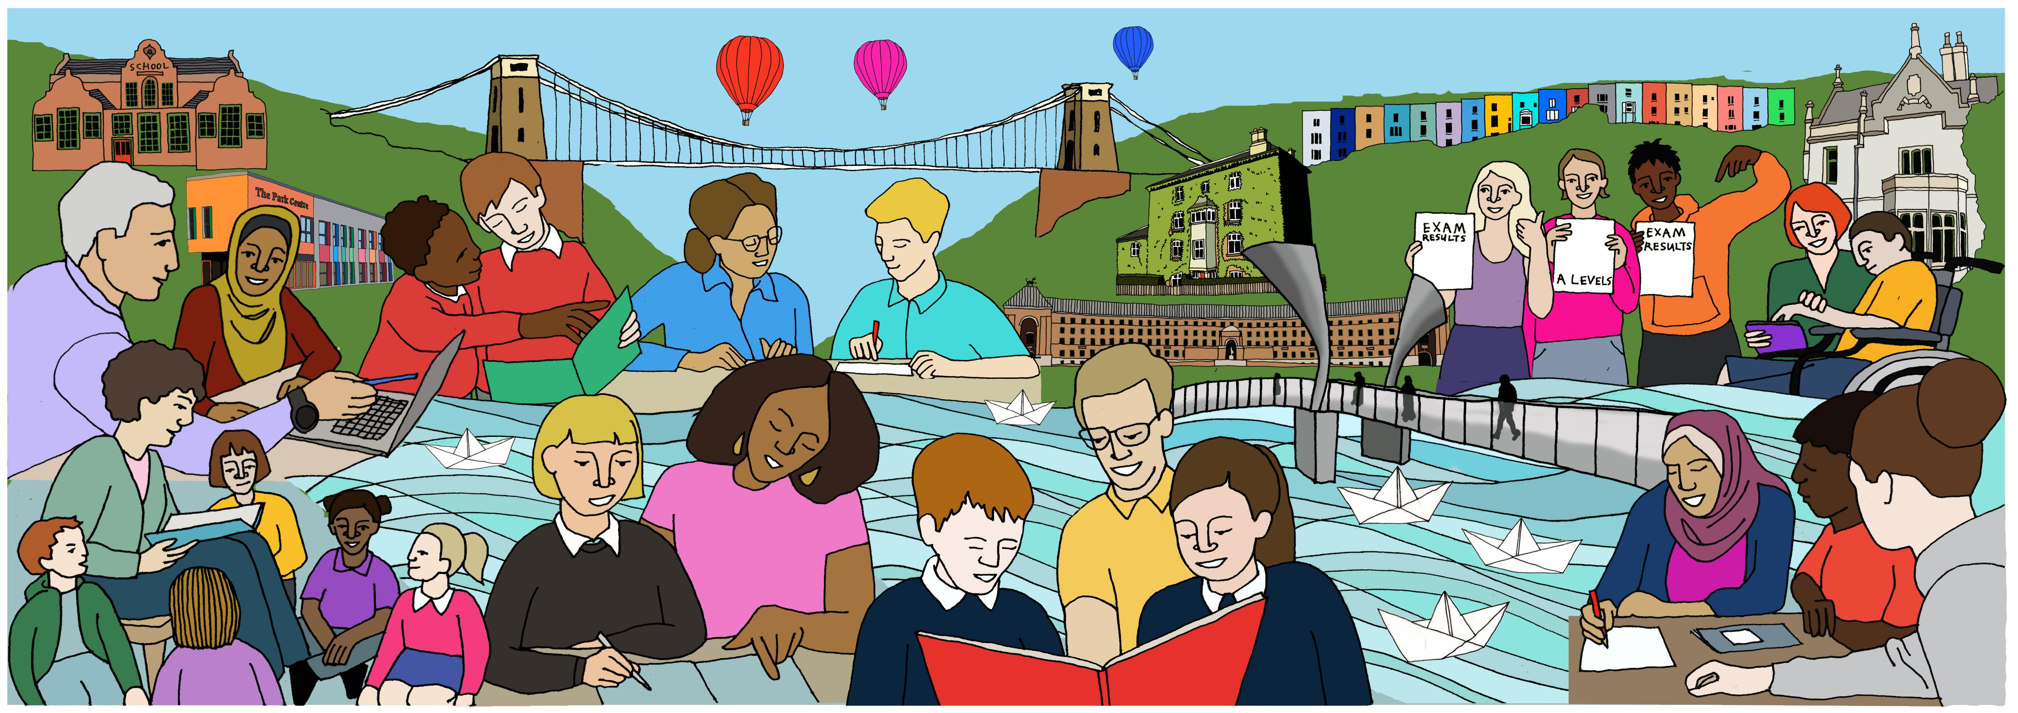

Safeguarding in Education Team

Slide 6
Agenda
SET Updates
Brook traffic light tool
Prevent
Memorial Day
Overview of Operation Barracan
Community Safety Incidents
Measles information pack/health protection update
Section 175 Audit

Slide 7

SET updates
E/C Education Safeguarding Advisor, Claire Lugg, has changed her role and left the Safeguarding in Education Team at the end of April. We wish her well as she continues her work within the local authority.
As a result, we will be looking to recruit to advisor roles shortly.
We have also successfully recruited to the Business Support Coordinator role and look forward to welcoming the new member of the team. Further communications will follow in due course to formally introduce them.

Slide 8

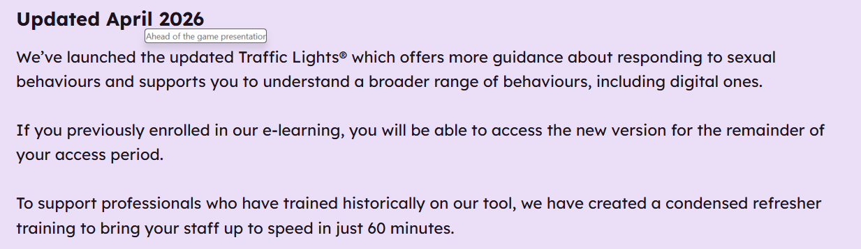
Brook Sexual Behaviours Traffic Light Tool

Slide 9

August 21st will be a new national day to remember the victims and survivors of terrorism.
The inaugural event will focus on supporting those affected by terrorism, sharing their stories and recognising the impact on their lives.
The date aligns with the UN International Day of Remembrance and Tribute to the Victims of Terrorism.
Educate Against Hate will be recognising and supporting this national event, with further information on plans for the inaugural day.
Sign up for the Educate Against Hate newsletter here

Slide 10
Title
Operation Barracan
Police investigation began in November 2023.
Suspects linked through association with a fruit and vegetable stall in Broadmead (central Bristol). Children and young people had been targeted by those working at or linked to the stall, invited to parties where they were given alcohol and drugs, and where sexual offences subsequently occurred.
Complex Police investigation spanning 5 Local Authority areas. Offences spanning 2022 – 2025. Large number of victims, witnesses & suspects.
In Summer 2024, the Operation Barracan Strategic Management Group was formed and the series of complex strategy meetings were replaced by the Operation Barracan Tactical group.
Rapid Review 25 – summary

Slide 11
KBSP –learning briefing
The Keeping Bristol Safe Partnership on 21st April 2026 published a learning briefing following a rapid review into Group Based Child Sexual Exploitation (CSE). This can be located on the KBSP Bristol Rapid Reviews webpage.
It is vital that learning from Child Safeguarding Rapid Reviews is shared and embedded in practice. This learning briefing has been developed to support professionals in individual learning, team meetings, and supervision, helping to ensure that key findings are disseminated widely across workforces and partnerships.
Summary slides are also provided to offer additional context to the review, its findings, and the Rapid Review process. Please note that these slides are the property of the KBSP and must not be shared beyond your organisation without the explicit permission of the author or the Chair of the Keeping Children Safe Partnership.

Slide 12
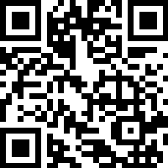
Community Safety- Incident comms
Incidents across the city this year, including online concerns and other high-profile incidents highlighted the need for timely and consistent communication with education settings.
There were large variations in how settings responded—ranging from no communication to broad universal messages to sharing intelligence between settings—leading to some confusion, reduced trust, and some increased community anxiety.
The Safeguarding in Education Team has worked with the Council’s Communications Teams to create a generic ‘holding message’ for use during urgent or critical situations.
The Teams want to hear from you about resources and guidance that will help settings manage misinformation and avoid inadvertently spreading disinformation.
The aim is to support a consistent citywide approach, helping settings:
acknowledge incidents or concerns
reassure families
signpost to appropriate services
reduce misinformation/disinformation.

Slide 13
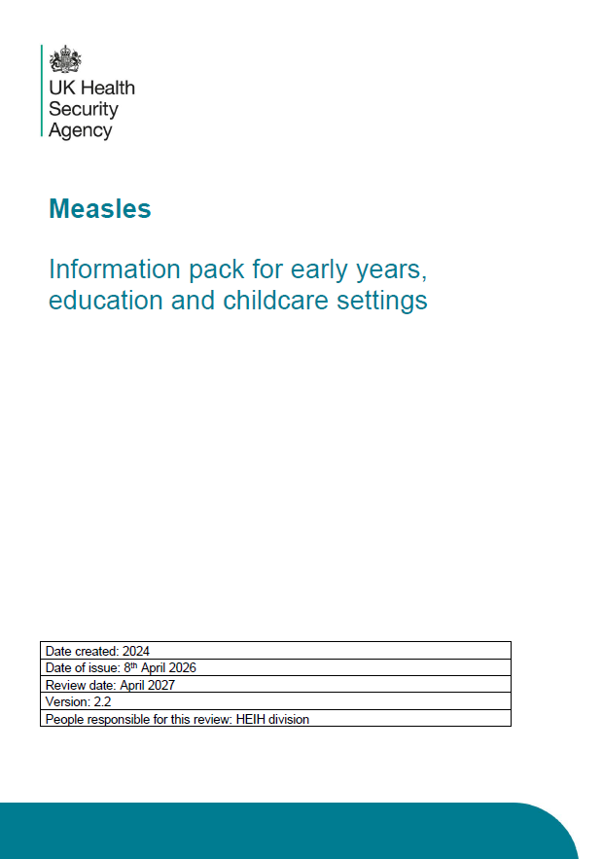
Measles information pack
The Measles standardised pack has been updated as an action from the current measles Incident Management Team.
For use with early years, educational settings, and childminders.
This version should now replace any other measles packs in use for these settings.

Slide 14
Reminder of UK Health Security Agency (UKHSA) Contact Details and Useful Links
Should you need any advice or guidance regarding an infectious disease concern within your education setting, you can contact the UKHSA South West Health Protection Team via the following:
Phone: 0300 303 8162
Email: swhpt@ukhsa.gov.uk
Links which may be of use:
Managing specific infectious diseases: A to Z - GOV.UK
Is my child too ill for school? - NHS
This poster can be displayed in education settings: Should I keep my child off school checklist poster
Immunisation Update
A reminder that Sirona Care and Health is the School-aged Immunisations Provider for Bristol. The service is offered primarily in schools and community catch-up clinics are available for anyone who has missed their vaccination in school or who does not attend school. For more information:
School Age Immunisation – Children and Young People’s Services
Vaccination - BNSSG Healthier Together
Health Protection Update

Slide 15
Farm visits and ticks
While farm visits are enjoyable and educational, they carry a risk of infection from animals or the environment. How to have a fun and healthy farm visit with the family – UK Health Security Agency sets out clear, practical advice for example on handwashing, and food hygiene, as well as what to do if symptoms develop after a visit.
The UKHSA farm visits toolkit has been updated and there are social assets there to be used in your setting if appropriate Farm visits - Google Drive
UKHSA encourages everyone to ‘be tick aware’.
A tick is a tiny spider-like creature that lives on animals such as sheep or deer. The main tick feeding season is late spring, early summer and autumn, when they can bite if you are walking through a tick infested area. Ticks can also be carried home by pets and dogs. Some ticks can pass on the bacteria that causes Lyme disease.
If you have been bitten by a tick please visit NHS.UK or the UKHSA Lyme disease page for more information.
Tick resources can be found here Tick awareness and toolkit - GOV.UK
Health Protection Update

Slide 16
s.175 Audit
If you cannot access your audit and need a copy sent to you that you can complete, contact the team: safeguardingineducationteam@bristol.gov.uk
Ensure you have included evidence for each statement to support your RAG rating.
If we have shared a copy with you to work from, put a reminder in your diary to email this when completed to your SET Advisor.
If you can access SharePoint and have been working on a live version, ensure this is up to date by the end of term 6.
Ensure you have shared a copy with your governance, and they have commented and signed the relevant page by the end of term 6.
DEADLINE 31ST JULY 2026

Slide 17
Sleep –updates from Sept 2026
•Government plans to amend the EYFS Statutory Framework to strengthen safeguarding requirements for sleeping arrangements.
•Subject to parliamentary process, these updates would come into force September 2026.
•Follows the deaths of Genevieve Meehan and Noah Sibanda due to unsafe sleeping practice and management
•Early Education Minister Olivia Bailey states ‘It is already expected that early years providers must put children down safely to sleep. All early years providers are required to meet the safer sleep requirements set out in the EYFS statutory framework, which currently links to the NHS safer sleep guidance.’ she is ‘updating the wording in the EYFS framework so that requirements around safer sleep are set out directly within the framework itself’.
•Updated info has had input from the Lullaby Trust, medical experts and Ofsted

Slide 18
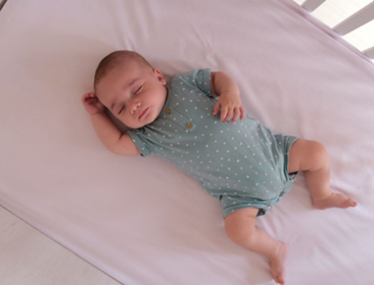
Proposed updated detail:
•Babies and children must be placed down to sleep safely.
For children under two years old, providers must ensure that:
•Children are placed down on their back in their own separate sleep space on a firm flat surface such as a cot, bed or mattress on the floor. Babies aged one year and under must only be placed to sleep in a cot.
•Sleep spaces should only contain a firm, flat, waterproof mattress and lightweight bedding which is firmly tucked in around the child below their shoulders to prevent head covering. Alternatively, a well fitted baby sleep bag may be used. Check the manufacturer recommendations before using a baby sleep bag.
•Where blankets are used, the child is placed feet-to-foot at the bottom of the cot, with blankets tucked in.
•Cots must not contain extra items such as toys, pillows, extra blankets, bumpers, wedges or straps.
•Children should not get too hot or cold. The recommended room temperature for babies is 16 – 20˚C.
•Children’s heads are not covered.
•Children under six months of age must always have an adult with them in the same room for every sleep.
All children must be frequently checked when sleeping.
•Children are always within sight and hearing of staff when sleeping.
•Providers must ensure that all staff read NHS advice on sudden infant death syndrome (SIDS).

Slide 19
Clarification of the detail:
Until the changes come into effect, Ofsted will inspect according to the current EYFS frameworks for group based providers and childminders, which links out to NHS safer sleep guidance. Providers should already be acting in accordance with the NHS guidance.
In the future iteration of the EYFS, for the requirements on safe sleep we will clarify ‘babies’ to refer to those aged 12 months and under.
babies aged 12 months and under must only be placed to sleep in a cot -‘cot’ refers to cots, carrycots, moses baskets and travel cots.
Children aged over 12 months must be placed down on their back in their own separate sleep space on a clear, flat, firm surface such as a cot, bed or suitable mattress on the floor.
Sleep comforters may be used for babies and children aged over 12 months only.
Babies under six months of age must always have an adult with them in the same room for every sleep. This is stated in the NHS guidance which the EYFS currently links out to.
Children over six months of age should always be within sight and hearing of staff whilst they are sleeping. A baby monitor that allows the child(ren) to be seen and heard at all times may be used but all children must still be frequently checked when they are sleeping.
Once babies can move from their back to their front and back again by themselves they can find their own sleeping position. However, continue to place them on their back to sleep

Slide 20
Buggies…
Can children sleep in prams, buggies, push chairs and car seats?
•Buggies, pushchairs and prams should not form the main separate sleep space for babies or children of any age.
For babies aged 12 months and under that fall asleep whilst travelling:
•They must be transferred to their cot once they return to the setting. Hats and extra clothing should be removed as soon as you come indoors or enter a car, bus or train, even it means waking the baby – Sudden infant death syndrome (SIDS) – NHS.
For children aged over 12 months that fall asleep whilst travelling:
•They should, where possible, be transitioned to their own separate sleep space on a clear, flat, firm surface such as a cot, bed or suitable mattress on the floor upon return. A lie-flat pram or lie-flat pushchair should not be their main separate sleep space. Coats, hats and blankets should be adjusted to prevent overheating.
•If a baby or child of any age falls asleep whilst travelling in a car seat, they must be transferred to their separate sleep space as soon as they return to the setting.

Slide 21
Links to the info:
•Help for early years providers : Safer sleep
•Early Years Foundation Stage (EYFS): Safer sleep requirements – Frequently Asked Question - Foundation Years
NHS guidance
BCC support:
•Sleep baby and you - Bristol Early Years – sample BCC policy for sleep and the registration form for sleep training
Becky Newman becky.newman@bristol.gov.uk

Slide 22
Julie Edwards
BAND

Slide 23
Fiona Townsend
Early Years Updates

Slide 24

NSPCC Learning has published a new series of Talk PANTS videos.
Talk PANTS is an NSPCC campaign to keep children safe from sexual abuse and includes a range of resources.
The new videos are funded by The Executive Office in Northern Ireland and include an introduction to what Talk PANTS is. They also feature videos for use with children aged between 3- to five-years-old
PANTS resources for schools and teachers | NSPCC Learning | NSPCC Learning

Slide 25
Early Years screen use
The Department for Education (DfE) has published findings from an independent report reviewing evidence on the effects of screen use by children under 5-years-old.
The Early Years Screen Time Advisory Group report draws on a review of scientific literature and discussions with parents, carers, children and professionals. It acknowledges that current research on the harms and benefits of screen use in young children is limited and often low quality.
Key findings and recommendations include:
-responsive interaction between parents and children when using screens can prevent harms and promote development for young children;
-time matters and parents should remain cautious about screen use in young children; and what children are viewing is important in determining whether screen use brings harms or benefits.
Main points:
Under 2yrs; avoid screen time other than for shared activities with family that encourage bonding.,
interaction and conversation.
2-5yrs;try to keep it to 1 hr a day. Less if possible.
Screen use by children aged under 5 - GOV.UK
Baby and toddler screen time guidance - Best Start in Life

Slide 26
Multi-Agency Working
Key updates include a stronger focus on;
Challenging racism and discrimination
Recognising the needs of babies
Understanding domestic abuse
Addressing multiple harms
Improvising inclusion for children in care
Linking online harm with in-person harm
Key changes introduced in Working together to safeguard children 2026

Slide 27
Early Years Updates
Giving Every Child the Best Start in Life
The briefings are online and you can register
Monday 8th June at 9.30am – 11.00am
Tuesday 9th June at 2.00pm – 3.30pm
Thursday 11th June at 5.30pm – 7.00pm
Notes:
FT
Early Years professionals are invited to dedicated briefing sessions on GIVING EVERY CHILD THE BEST START IN LIFE and the publication of BRISTOL BEST START IN LIFE PLAN
The briefings have been arranged for the following dates: A morning, an afternoon and a twilight session
These briefings will set out Bristol’s shared vision for improving outcomes for babies and young children, with a strong focus on prevention, inclusion and reducing inequalities.
It will highlight how early years providers play a vital role in supporting children’s development, wellbeing, and school readiness during the critical first years of life.
More information can be found in the May SWAY, with bookings via eventbrite

Slide 28
Early Years Updates
Low Level Concerns Training by LADO – dates booked;
May 19th 9.30am-11.30am and July 7th 9.30am- 11.30am
Safeguarding Audit- deadline is 31st July 2026
DfE Prevent in Education Training
Regional CONTEST co-ordinators - GOV.UK
New email eysafeguarding@bristol.gov.uk

Slide 29
Thank-you for attending this session.
If you have any questions or topic ideas for future meetings, please email them to us and we can liaise with the relevant person and respond to you.
eysafeguarding@bristol.gov.uk
askcyps@bristol.gov.uk

