Slide 1



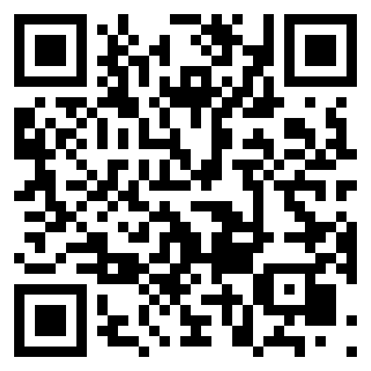
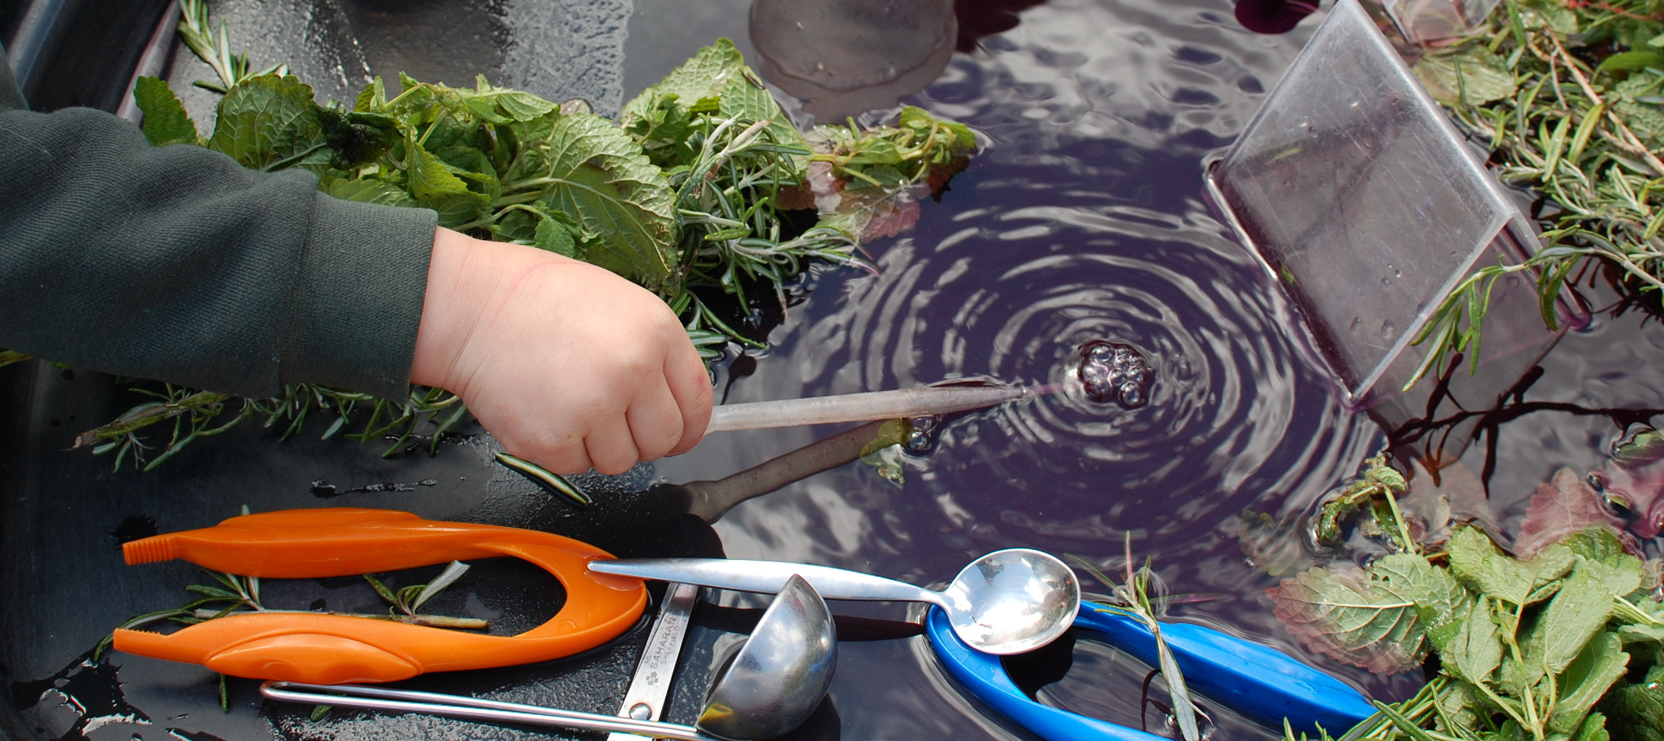
BRISTOL EARLY YEARS
Professional development overview - Terms 1& 2 2026-27
Fostering ambition, tackling inequality and promoting continuous improvement in the early years
Early Years Managers Clusters
Citywide Networks
Other CPD
North – 6th Oct & 17th Nov
East Central – 13th Oct & 24th Nov
South – 29th Sept & 24th Nov
Behaviour Circle – 15th Oct
Equality Diversity & Inclusion - 2nd Oct, 16th Oct, 27th Nov
Terrific Twos Network – 14th Oct
& 9th Dec
3 & 4 Year Olds Network - 6th Oct
Reception Provision Workshops – 25th Nov
Early Years Leaders In Schools – 25th Nov
Head Teachers & Early Years Leaders Briefing – 12th Oct
DfE – LA Reception Assessment Workshop - TBC
School Clusters
Unlocking Outdoors Network - 28th Sept
North – 10th Nov
East Central – 10th Nov
South – 10th Nov
Enhancing creativity through Art – 12th Oct​
Bristol Baby Practitioner
Cluster
Safeguarding
DSL Network 13th Oct & 15th Oct
North – 2nd Nov
East Central – 1st Dec
South – 21st Oct
Book here:
SALT
Stronger Practice Hub CPD
calendar.bristolearlyyears.org.uk
Early Years Speech & Language Therapy – Children and Young People’s Services
Bristol & Beyond Stronger Practice Hub - Bristol Early Years Teaching Hub

